Slide 1
Lecture #5
SOFT COMPUTING
INT508

Slide 2
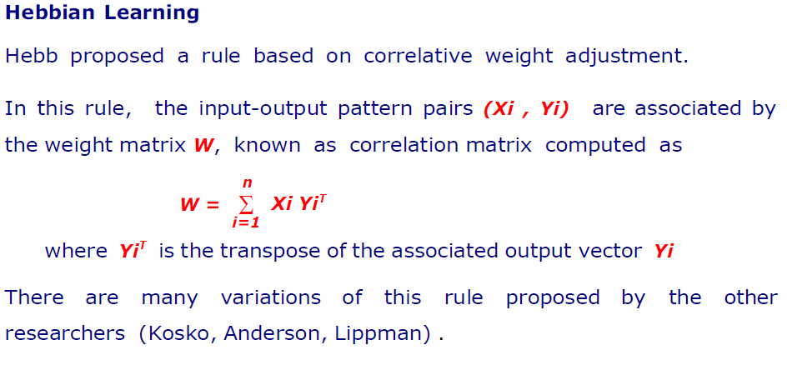
Classification of Learning Algorithms

Slide 3
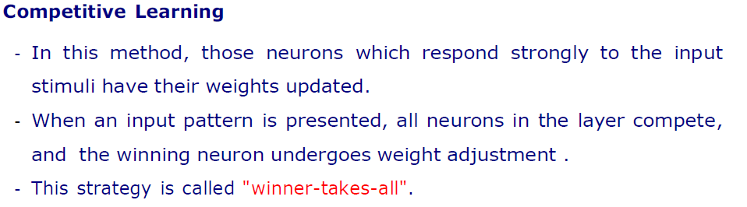
Classification of Learning Algorithms

Slide 4
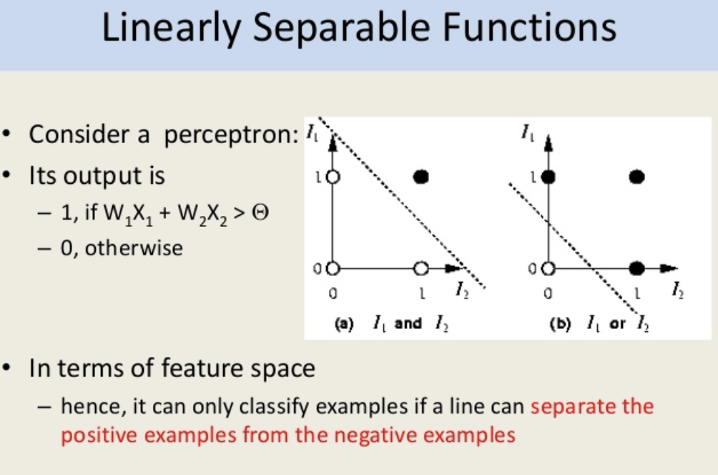

Slide 5
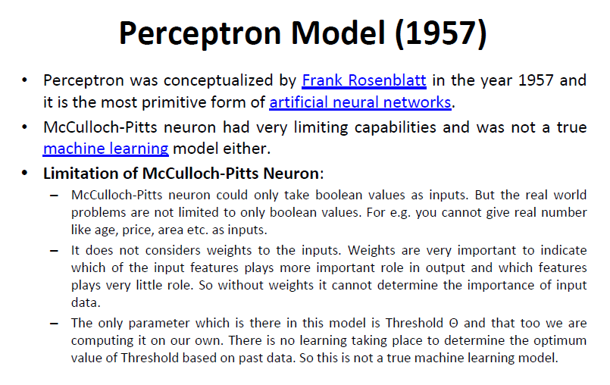

Slide 6
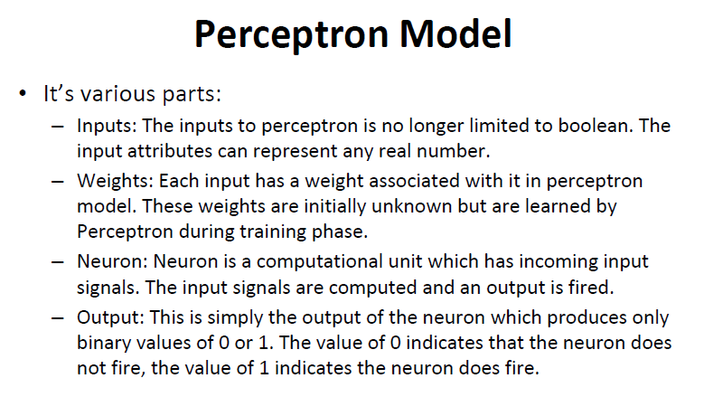

Slide 7
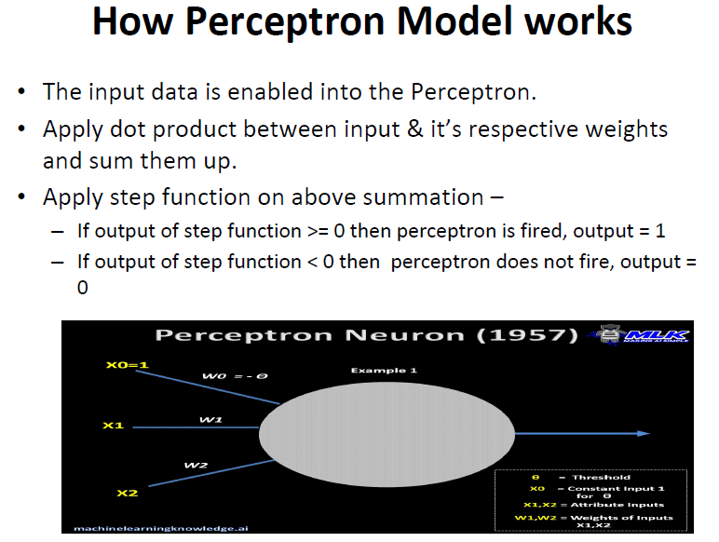

Slide 8

The Perceptron
The perceptron is the most basic model of the ANN. It consists of a single neuron. The perceptron may be seen as a binary classifier that maps every input to an output that is either 0 or 1.
The perceptron is given by the function represented by Equation
where w is the vector of real-world weights, x is the input, “.” is the dot product of the two vectors, and b is the bias.
The perceptron has learning capabilities in that it can learn from the inputs to adapt itself. As a result, the perceptron is able to learn historical data.

Slide 9
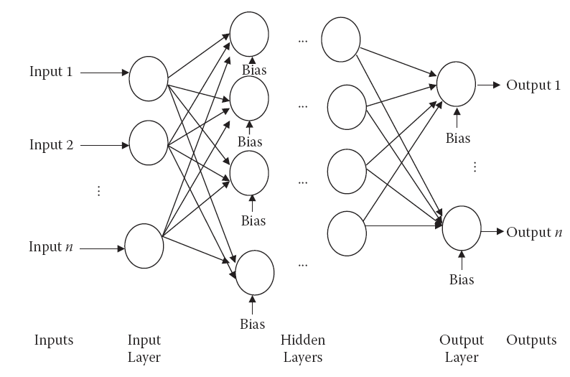
Multilayer Perceptron
Multilayer perceptrons are networks used to overcome the linear reparability limitation of the perceptrons.

Slide 10
Multilayer Perceptron
An MLP consists of
1. An input layer,
2. At least one intermediate or “hidden” layer,
3. And one output layer
The neurons from each layer being fully connected (in some particular applications, partially connected) to the neurons from the next layer.
The number of neurons in the input layer is equal to the number of inputs of the system. Each neuron corresponds to one input.
In output layer, the number of neurons is equal to the number of outputs that the system is supposed to provide.
The number of layers decides the computational complexity of the ANN.

Slide 11
Types of Data Involved
The data is generally divided into three sets
  Training data : These data are used by the training algorithm to set the ANN’s parameters, weights, and biases. Training data make up the largest set of data, comprising almost 80 percent of the data.
  Testing data: This data set is used when the final ANN is ready. Testing data, which are completely unknown, are used to test the system’s actual performance. The testing data set consists of about 10 percent of the data.
  Validation data: These data are used for validation purposes during the training period. At any point during training, we measure the error on both the training data and the validation data. The size of this data set is about 10 percent of the entire data set.

Slide 12
Training
ANNs are able to learn the data presented in a process known as training
The training algorithm tries to adjust the various weights (and biases) and set them to a value such that the ANN performs better at the applied input.
Note that each ANN might not be able to train itself well for all architectures.
This performance and training depends on the number of hidden layers as well as on the neurons in these hidden layers.
Changing the architecture cannot be performed during training.
Because this entire activity is manual, it may take a long time and a great deal of experience before a designer is able to selects a final design.

Slide 13
Stopping Condition
The algorithm stops according to the stopping condition. Normally one or more of the following criteria are used as stopping conditions:
  Time: The algorithm may be stopped when the time taken to execute exceeds more than a threshold.
  Epoch: The algorithm has a specified maximum number of epochs. Upon exceeding this number, the algorithm may be stopped
  Goal: The algorithm may be stopped if the error measured by the system reduces to more than a specific value. It may not be useful to continue training after this point.
  Validating data: If the error on validation data starts increasing, even if there is a decrease in the testing data, it would be better to stop further training.
  Gradient: Gradient refers to the improvement of the performance or the lowering of the error in between epochs.

Slide 14
Q & A
1. Artificial Intelligence is the XOR problem exceptionally exciting to neural network researchers because it can be?
(A). expressed in a manner that permits you to use a neural network
(B). the simplest linearly inseparable problem that exists.
(C). solved by a single layer perceptron
(D). it is a complex binary operation and it is unsolvable using neural networks

Slide 15
Q & A
1. Artificial Intelligence is the XOR problem exceptionally exciting to neural network researchers because it can be?
(A). expressed in a manner that permits you to use a neural network
(B). the simplest linearly inseparable problem that exists.
(C). solved by a single layer perceptron
(D). it is a complex binary operation and it is unsolvable using neural networks

Slide 16
Q & A
2. A perceptron receives the weighted inputs and totals up, and if it increases a certain value, the value of its output will be 1, otherwise, it just outputs the value of 0.
(A). True
(B). False
(C). Occasionally, it can also output intermediary values as well
(D). None of these

Slide 17
Q & A
2. A perceptron receives the weighted inputs and totals up, and if it increases a certain value, the value of its output will be 1, otherwise, it just outputs the value of 0.
(A). True
(B). False
(C). Occasionally, it can also output intermediary values as well
(D). None of these

Slide 18
Q & A
3. What is hebb’s rule of learning
a) the system learns from its past mistakes
b) the system recalls previous reference inputs & respective ideal outputs
c) the strength of neural connection get modified accordingly
d) none of the mentioned

Slide 19
Q & A
3. What is hebb’s rule of learning
a) the system learns from its past mistakes
b) the system recalls previous reference inputs & respective ideal outputs
c) the strength of neural connection get modified accordingly
d) none of the mentioned

Slide 20
Q & A
4. Who proposed the first perceptron model in 1957?
a) McCulloch-pitts
b) Marvin Minsky
c) Hopfield
d) Rosenblatt

Slide 21
Q & A
4. Who proposed the first perceptron model in 1957?
a) McCulloch-pitts
b) Marvin Minsky
c) Hopfield
d) Rosenblatt

Slide 22

12/12/14
CSE510, Lovely Professional University, Phagwara

